Slide 1



Webinar presentation
Pancreatic cancer
4th November 2014
Mr Ross Carter
West of Scotland Pancreatico-Biliary Unit
Glasgow Royal Infirmary
Disclosure statement
The speaker has no financial or commercial interests that may have influenced the content of the following presentation

Slide 2
Summary
Background
What is optimum treatment today?
What options for change have we?
Disclosure statement
The speaker has no financial or commercial interests that may have influenced the content of the following presentation

Slide 3
Poll
If a patient dies of cancer how likely is it that it is
a pancreatic cancer ?
(where does PDAC stand in the ranking of cancer deaths)
5
7
11
14

Slide 4
Hard facts;
Survival rates for pancreatic cancer have shown marginal gains in the last 40 years.
Pancreatic cancer still only has a 3% 5 year survival rate.
Pancreatic cancer is the 5th commonest cause of cancer death yet receives less than 1% of research funding.

Slide 5
Hard facts;
22 people die each day in the UK from pancreatic cancer.
Most people only learn about the pancreas when an illness affects someone they know.
90% of patients are diagnosed too late for potentially curative surgery.

Slide 6
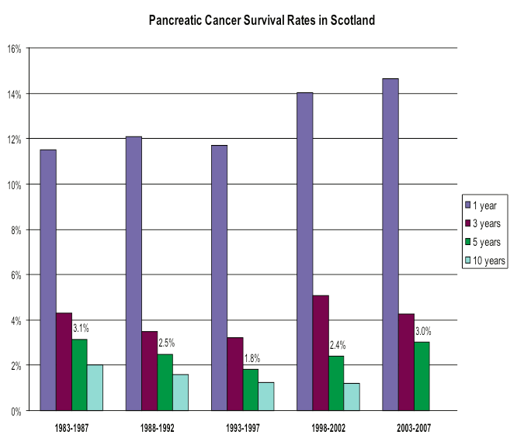

Slide 7
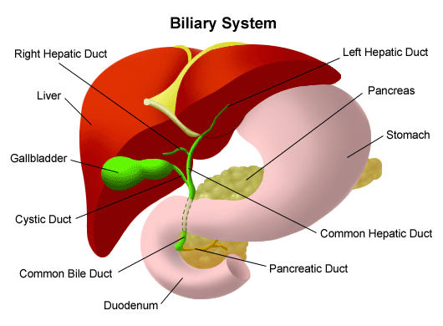
Medical school teaching
head body and
tail
Weight loss 92% 100%
Pain 72% 87%
Jaundice 82% 7%
Anorexia 64% 33%
Malaise 35% 43%
Vomiting 37% 37%
(Adler 1996)

Slide 8
Pancreatic cancer: Pathology All are epithelial tumours
Pancreatic ductal adenocarcinomas
Rarer exocrine tumours e.g. intraductal papillary mucinous tumour (IPMT), cystic mucinous or serous tumours, solid-pseudopapillary tumours, acinar cell carcinoma
Endocrine tumours (PET / ? p-NET)
Non pancreatic tumours ( Ampullary / Duodenal / CholangioCa)

Slide 9
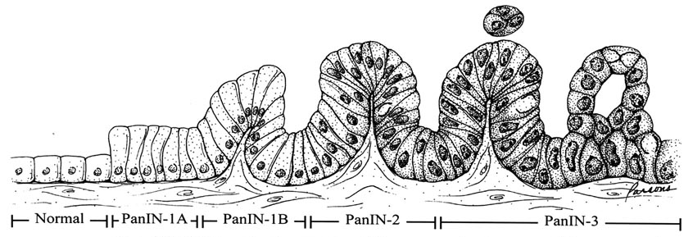

Slide 10
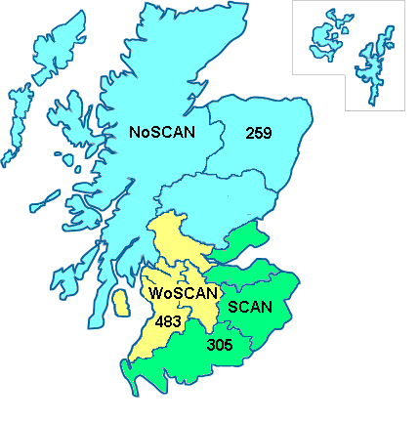
Scottish HpB Network Audit WOSCAN - 2.5M people (47.9%) SCAN - 1.4M people (28.6%) NOSCAN - 1.2M people (23.5%)

Slide 11

Scotland 2011 Males Females
Rank - incidence 12 8
Rank - mortality 5 5
Percentage frequency of all cancers 2.6% 2.5%
Number of new cases diagnosed in 2011 378 397
Number of deaths recorded in 2011 358 344
Change in incidence from 2001 to 2011 +17.5% +12.6%
Change in mortality from 2001 to 2011 +5.5% 5.3%

Slide 12
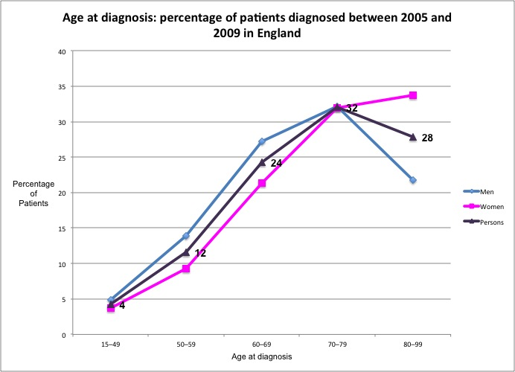
40% < 70yrs and 70% <80 yrs

Slide 13
Carcinoma of pancreas and deprivation index

Slide 14
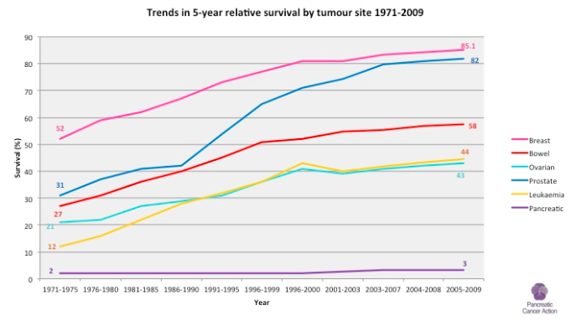

Slide 15
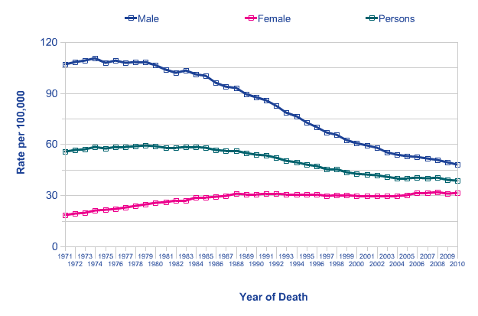
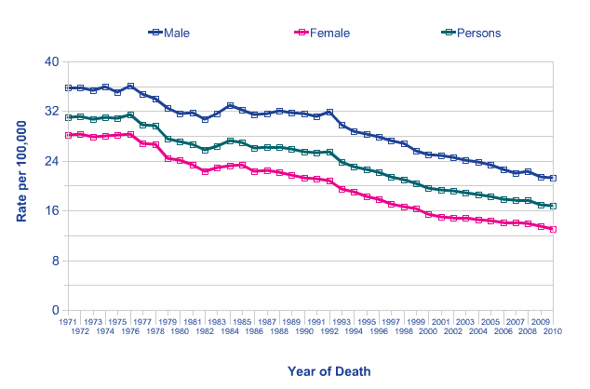
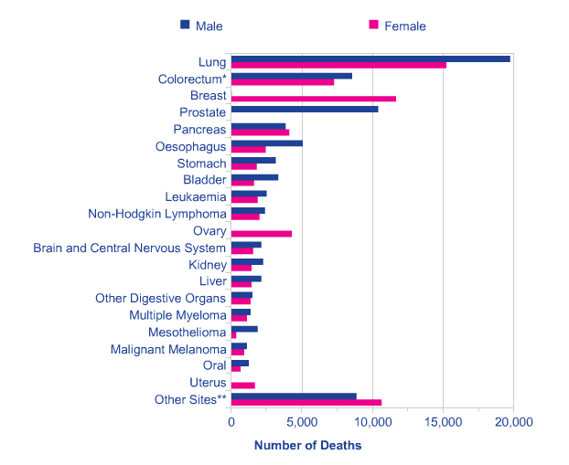
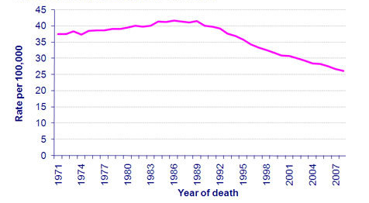
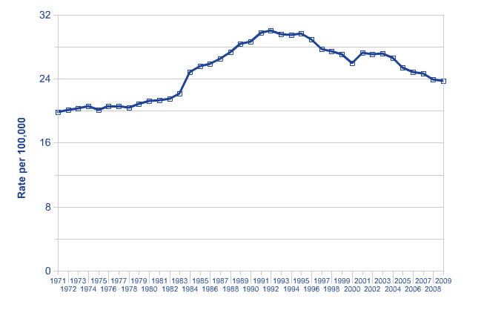
Rank cause of cancer death and trends over time
5th
Lung
Colorectal
By 2025 at current trends PDAC
will be 2nd rank
Breast
Prostate

Slide 16
Pancreatic patients – cancer treatment received
 | Scotland
 | N | %
Resection only | 20 | 3.6%
Resection + oncology | 41 | 7.4%
Palliative surgery only | 18 | 3.3%
Palliative surgery + oncology | 17 | 3.1%
Other operation | 2 | 0.4%
Oncology only | 96 | 17.4%
Refused treatment | 22 | 4.0%
Died before first treatment | 35 | 6.4%
No active treatment | 300 | 54.4%
Total | 551 | 100.0%
No active treatment includes those who had had other therapy, endoscopic treatment, supportive care, and watchful waiting

Slide 17
Why do they do so badly?
Late presentation
Systemic disease at presentation
Nihilistic attitude of the medical profession
Inappropriate selection for treatment
Correct access for treatment

Slide 18
Question for poll
What is the first line investigation for someone you suspect may have PDAC?
CA19-9
Ultrasound
CT
MR
ERCP

Slide 19
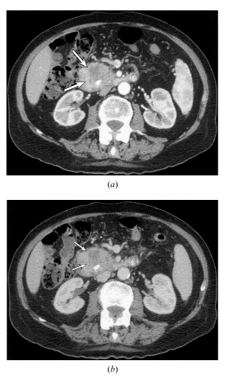
Diagnosis of pancreatic cancer
Ultrasound
Essentially a waste of time
CT
Demonstrates mass
> 0.5 – 1.0cm
Depends on protocol
“gold standard”
MR
= CT but less accessible
Blood
No good marker in blood or urine (CA19-9)

Slide 20
Poll
Have you direct (GP) access to CT?
Yes
No

Slide 21
How can we make a difference?
Improve tomorrows technology
Deliver todays best practice to more people

Slide 22
How can we make a difference?
Improve tomorrows technology
- Encourage and support research
Deliver todays best practice to more people
Improve management/network pathways
Improve % receiving active treatment
promote early diagnosis through awareness

Slide 24
How can we make a difference?
Deliver todays best practice to more people
address negative treatment outcomes
Surgical morbidity and mortality
Streamline pathways
Multi-modal patient optimisation
Improved palliation
Improved communication

Slide 25
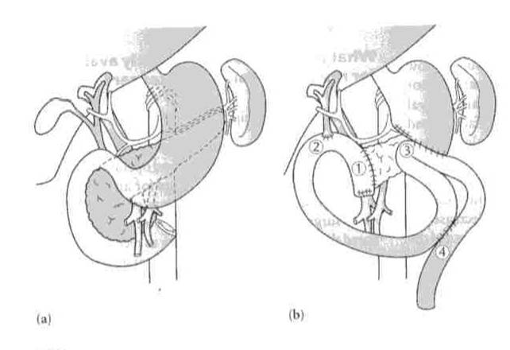
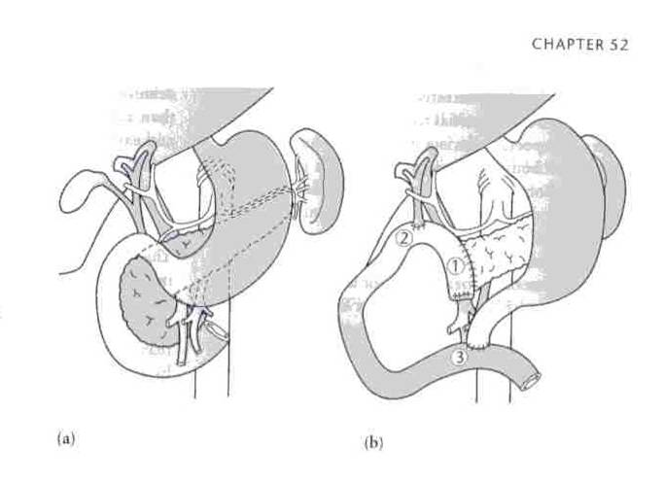
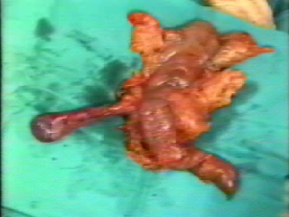
“Classical” Whipple
“Pylorus preserving” Whipple

Slide 26
Surgical morbidity and mortality
? Why is there a nihilistic attitude to pancreatic cancer

Slide 27
Treatment and survival in 13,560 patients with pancreatic cancer, and incidence of the disease, in the West Midlands: an epidemiological study
Bramhall SR,et al Br J Surg. 1995 Jan;82(1):111-5.
 | no of patients | exploratory laparotomy | bypass surgery | supportive care | resection rate
1957 - 1976 | 7888 | 1552 (19.7%) | 2760 (35%) | 3368 (42.7%) | 208(2.6%)
1976 - 1986 | 5672 | 825 (14.5%) | 2010 (35.4%) | 2710 (47.8%) | 145(2.6%)
 |  |  | 30 day mortality
 | No. having surgery | resection | bypass | laparotomy | overall
1957 - 1976 | 4520/7888 (57.3%) | 94/208 (45.2%) | 691/2760 (25%) | 873/1552 (56.3%) | 36.7%
1976 - 1986 | 2980/5672 (52.5%) | 40/145 (27.6%) | 436/2010 (21.7%) | 372/825 (45.1%) | 28.5%
Notes:
50 % undergoing surgery as pert of their initial treatment

Slide 28
Treatment and survival in 13,560 patients with pancreatic cancer, and incidence of the disease, in the West Midlands: an epidemiological study
Bramhall SR,et al Br J Surg. 1995 Jan;82(1):111-5.
 | no of patients | exploratory laparotomy | bypass surgery | supportive care | resection rate
1957 - 1976 | 7888 | 1552 (19.7%) | 2760 (35%) | 3368 (42.7%) | 208(2.6%)
1976 - 1986 | 5672 | 825 (14.5%) | 2010 (35.4%) | 2710 (47.8%) | 145(2.6%)
 |  |  | 30 day mortality
 | No. having surgery | resection | bypass | laparotomy | overall
1957 - 1976 | 4520/7888 (57.3%) | 94/208 (45.2%) | 691/2760 (25%) | 873/1552 (56.3%) | 36.7%
1976 - 1986 | 2980/5672 (52.5%) | 40/145 (27.6%) | 436/2010 (21.7%) | 372/825 (45.1%) | 28.5%
Notes:
50 % undergoing surgery as pert of their initial treatment

Slide 29
Treatment and survival in 13,560 patients with pancreatic cancer, and incidence of the disease, in the West Midlands: an epidemiological study
Bramhall SR,et al Br J Surg. 1995 Jan;82(1):111-5.
 | no of patients | exploratory laparotomy | bypass surgery | supportive care | resection rate
1957 - 1976 | 7888 | 1552 (19.7%) | 2760 (35%) | 3368 (42.7%) | 208(2.6%)
1976 - 1986 | 5672 | 825 (14.5%) | 2010 (35.4%) | 2710 (47.8%) | 145(2.6%)
 |  |  | 30 day mortality
 | No. having surgery | resection | bypass | laparotomy | overall
1957 - 1976 | 4520/7888 (57.3%) | 94/208 (45.2%) | 691/2760 (25%) | 873/1552 (56.3%) | 36.7%
1976 - 1986 | 2980/5672 (52.5%) | 40/145 (27.6%) | 436/2010 (21.7%) | 372/825 (45.1%) | 28.5%
Notes:
50 % undergoing surgery as pert of their initial treatment

Slide 30
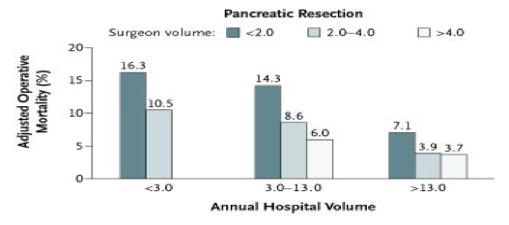
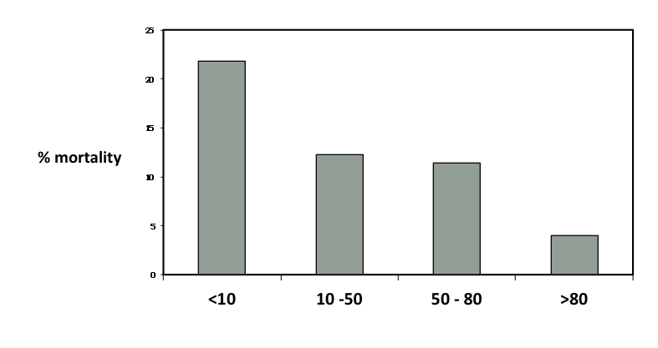
Improved mortality for surgical resection
in volume US centres
Lieberman MD, et al Ann Surg. 1995; 222(5): 638–645.
Birkmeyer JD et al. N Engl J Med. 2003; 349(22): 2117-27

Slide 31
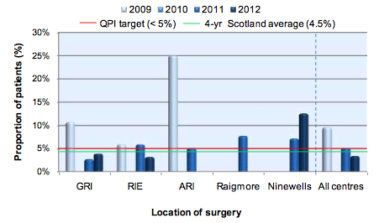
National resection mortality now < 5%
3% in larger volume units

Slide 32

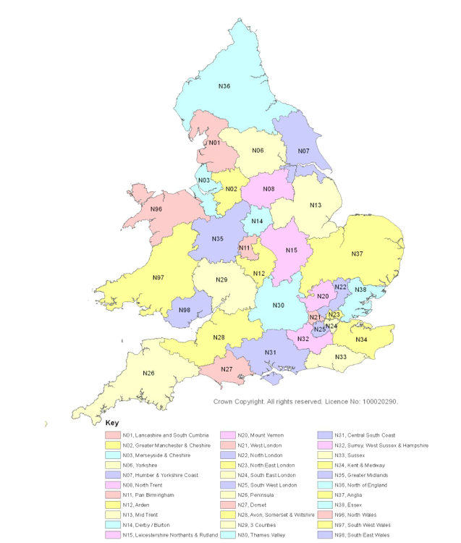
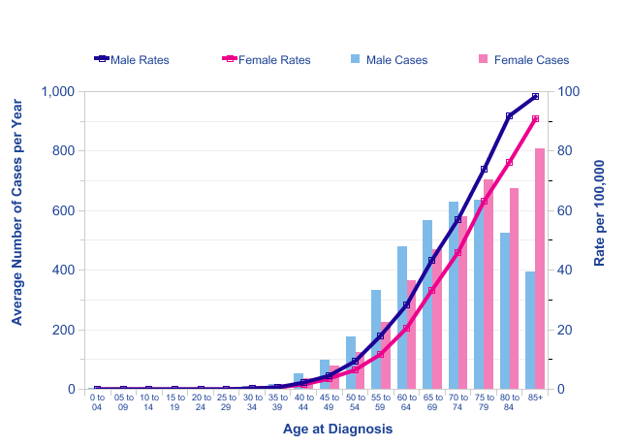
35 UK cancer networks
Northern Ireland 1
Scotland 3
Wales 3
England 28
Age at diagnosis
Notes:
Formation of Cancer networks with resourced audit

Slide 33
Pancreatic patients – actual cancer treatment received
 | Scotland
 | N | %
Resection only | 20 | 3.6%
Resection + oncology | 41 | 7.4%
Palliative surgery only | 18 | 3.3%
Palliative surgery + oncology | 17 | 3.1%
Other operation | 2 | 0.4%
Oncology only | 96 | 17.4%
Refused treatment | 22 | 4.0%
Died before first treatment | 35 | 6.4%
No active treatment | 300 | 54.4%
Total | 551 | 100.0%
No active treatment includes those who had had other therapy, endoscopic treatment, supportive care, and watchful waiting

Slide 34
Pancreatic patients – actual cancer treatment received
 | Scotland
 | N | %
Resection only | 20 | 3.6%
Resection + oncology | 41 | 7.4%
Palliative surgery only | 18 | 3.3%
Palliative surgery + oncology | 17 | 3.1%
Other operation | 2 | 0.4%
Oncology only | 96 | 17.4%
Refused treatment | 22 | 4.0%
Died before first treatment | 35 | 6.4%
No active treatment | 300 | 54.4%
Total | 551 | 100.0%
65%
No active treatment includes those who had had other therapy, endoscopic treatment, supportive care, and watchful waiting

Slide 35
Increasing the number treated:
Faster assessment
Prevention of “in staging” deterioration
Improved treatment options
Better communication

Slide 36
Rapid assessment clinics:
PDAC seen as an oncological emergency
Management supervised by a pathway coordinator
Rapid access multidemensional clinic centred on endoscopy unit (EUS/ERCP/dietetic/CNS)
Simultaneous diagnosis,staging and early management
Early MDT management planning
Patient optimisation (Biliary drainage? / PERT / ONS)

Slide 37
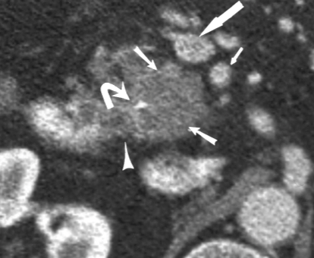
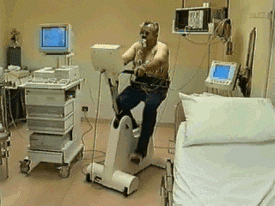
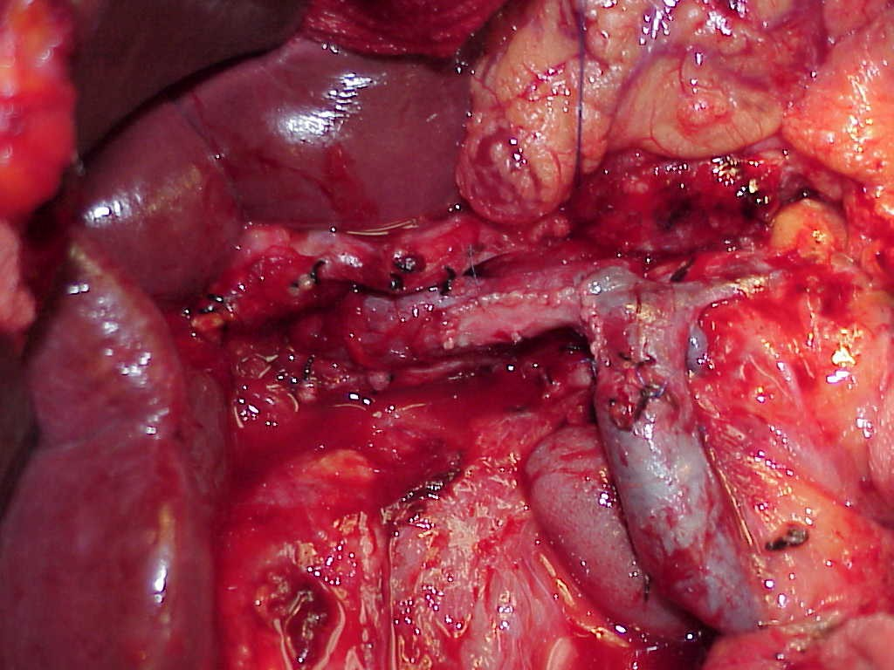
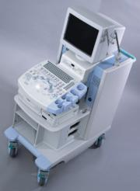
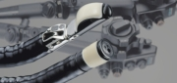
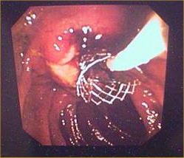
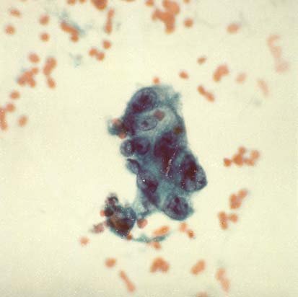
Diagnosis
and rapid
assessment
Nutritional
and
Physical
optimisation
resection

Slide 38
Diagnosis
and rapid
assessment
Nutritional
and
Physical
optimisation
resection
CXT
Increase numbers
receiving active treatment

Slide 39
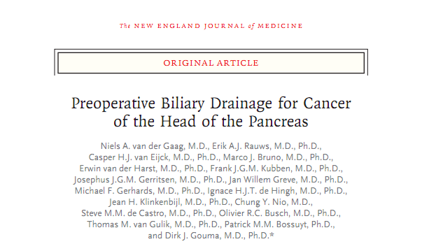
DROP-trial (DRainage vs. OPeration)
(Bilirubin < 250)
N Engl J Med. 2010 Jan 14;362(2):129-37
Notes:
Education and training a good example being the DROP study

Slide 40
DROP-trial (DRainage vs. OPeration)
N Engl J Med. 2010 Jan 14;362(2):129-37
 | Early Surgery ( n=94) | Pre op drainage ( n= 102)
Complications - overall - pre op drainage - Surgery - other( non protocol) | 37(39%) 2(2%) 35(37%) 30(32%) | 75(74%) 47(46%) 48(47%) 25(25%)
Death - protocol - any cause | 4(4%) 12(13%) | 9 (9%) 15(15%)
Bilirubin | 151 +/- 58.7 | 154+/- 59.5
BMI | 24+/- 3.1 | 25 +/- 3.9
Age | 64.7+/- 9.5 | 64.7 +/- 10.5
Adequate drainage – 1st attempt - 2ndattempt (ERC or PTC) | 5(%) - | 77(75%) 96(94%)
Resection Bypass | 63(67%) 31(33%) | 57(56%) 45(44%)
Mean time to surgery | 1.2weeks (95% CI 09-1.4) | 5.2 weeks (95% CI 4.8-5.5)
http://youtu.be/sNB57_vcFFU
35% reduction in risk of complications by avoiding pre-operative drainage

Slide 41
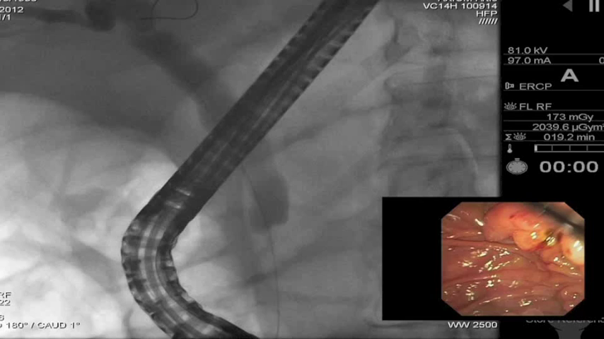
Re-evaluation of the role of ERCP
in neoplastic disease
Changing investigation and management
algorithm(EUS / MR / CT PET / CPEX )
ERCP has moved from initial diagnosis to
an integrated treatment modality
SEMS > plastic stents
Emergence of evidence that some
intervention is unnecessary or
potentially harmful
(Neoadjuvant CXT)

Slide 42
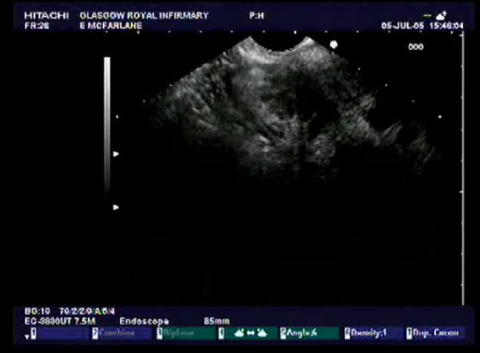
EUS in pancreatic cancer: tissue diagnosis
Fine needle aspiration cytology
Core biopsy

Slide 43
Immediate nutritional intervention
Oral nutritional supplements PERT dietary advice physiotherapy
? But does it work

Slide 44
GRI: Nutritional audit in PDAC(unpublished data)
75% staging precludes attempted curative treatment
25% have lost >10% body weight at presentation
Further 25% loose >10% body weight by treatment initiation
with an associated drop in performance status
Therefore were poor at:
Selecting patients for surgery
Addressing the “nutritional emergency”
Optimising the numbers that are fit for treatment

Slide 45
75% staging precludes attempted curative treatment
25% have lost >10% body weight at presentation
Further 25% loose >10% body weight by treatment initiation
with an associated drop in performance status
Therefore were poor at:
Selecting patients for surgery
Addressing the “nutritional emergency”
Optimising the numbers that are fit for treatment
? For surgery -------? For CXT---------? For palliation ---?

Slide 46
Study groups
Controls: If patients at nutritional risk, then CNS and consultant notified. ONS/CREON Px through GP.
One follow-up at pancreatic clinic.
Intervention: Patients with symptoms of anorexia or weight loss or both or other symptoms which may interfere with their ability to meet nutritional requirements were:
Rx ONS (usually 2 bottles a day)
Food fortification advice
Exercise advice
Follow-up at pancreatic clinic and once a month thereafter until surgery or until patient was happy to attend

Slide 47
Recruitment
199 patients
36 patients non-Ca
81
Intervention
82
Controls
48
Follow-up
34
Baseline
39
Follow-up
42
Baseline
21
Wt losing*
26
Wt stable*
21
Wt stable*
15
Wt losing*
*X², p=0.785

Slide 48
Weight stabilisation on follow-up
All patients:
55% (26 out of 47) - control group
vs.
58% (21 out of 36) - intervention group
(p=0.785)
≥10% weight loss at baseline:
50% (9 out of 18) - control group
vs.
55% (11 out of 20) - intervention group
(p=0.761)
NOT related to extent of weight loss at presentation

Slide 49
Diagnosis
and rapid
assessment
Nutritional
and
Physical
optimisation
resection
CXT
Increase numbers
receiving active treatment

Slide 50
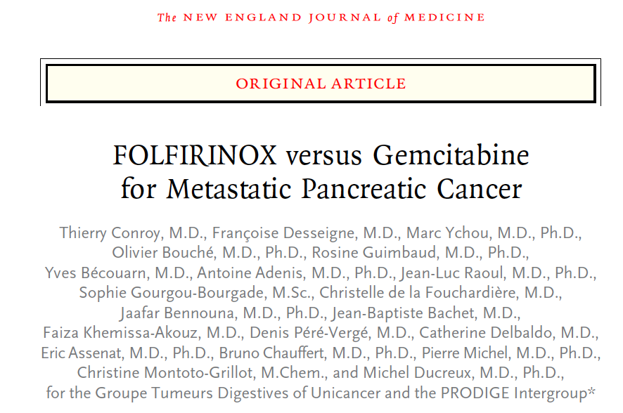
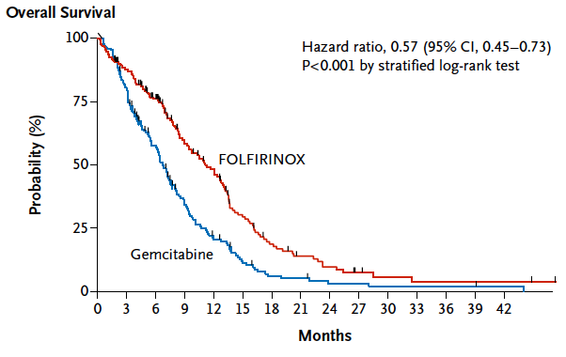
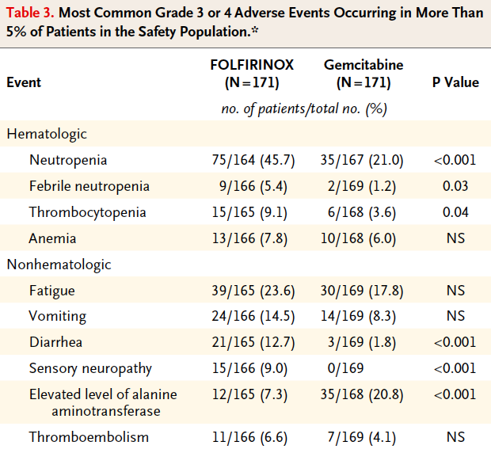
Impact of FOLFIRINOX compared with gemcitabine on quality of life
Gourgou-Bourgade S, et al
J Clin Oncol. 2013 Jan 1;31(1):23-9 FF > Gem

Slide 51
Impact of FOLFIRINOX compared with gemcitabine on quality of life
Gourgou-Bourgade S, et al
J Clin Oncol. 2013 Jan 1;31(1):23-9 FFX > Gem

Slide 52
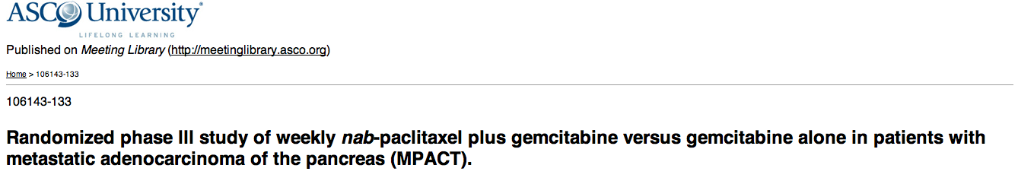
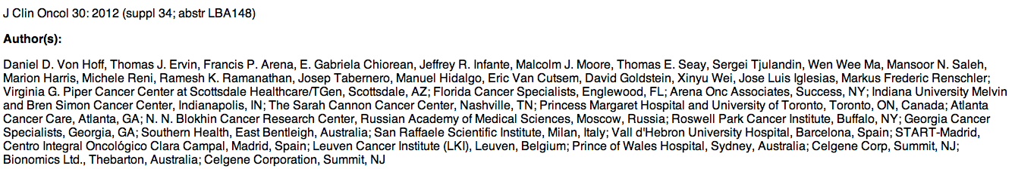
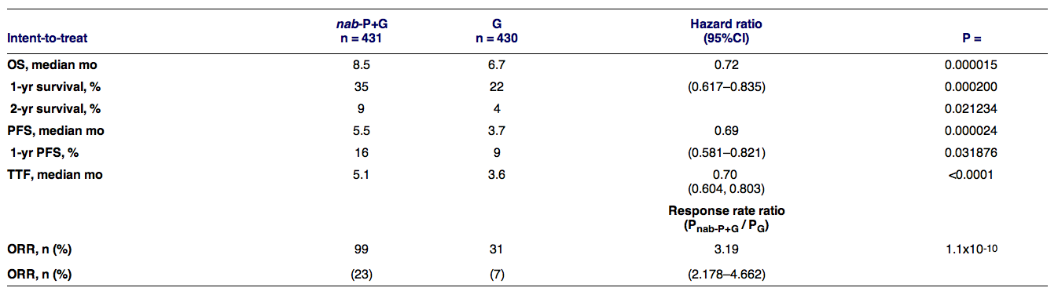

Slide 53
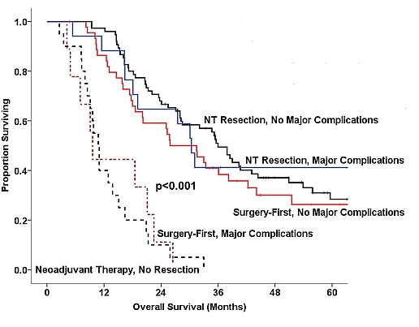
Treatment Sequencing for Resectable Pancreatic Cancer:
Influence of Early Metastases and Surgical Complications on Multimodality Therapy
Completion Rates and Survival
Ching-Wei D. Tzeng CD et al, MD Anderson Cancer Centre Houston Tx.
DDW 2013

Slide 54
Diagnosis
and rapid
assessment
Nutritional
and
Physical
optimisation
Downstage
borderline
Resectable PDAC
Neo ad CXT
resection
Progression of
biologically aggressive
tumours

Slide 55
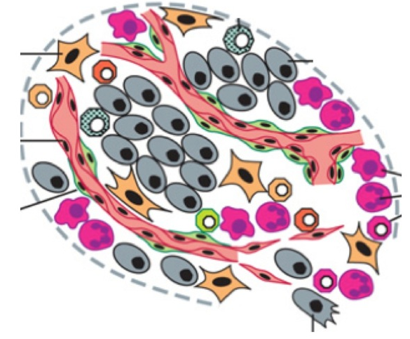
Inflammation and pancreatic cancer
Pancreatic cancer
Obesity
Smoking
Chronic pancreatitis
Tumor /Stroma microenvironment
Initiation
Promotion
Progression
Inflammation
Pancreatic cancer risk associated with inflammatory processes
Cigarette smoking pancreatic fibrosis, raised systemic markers of inflammation,
chronic pancreatitis risk
Obesity Adipokine profile pro-inflammatory, markers of inflammation, severe AP
Chronic pancreatitis Cigarette smoking, alcohol causes cell necrosis, reactive oxygen species
Hereditary pancreatitis over-active trypsin → chronic inflammatory state fibrosis
Notes:
Pancreatic cancer ranks 6th in cancer related mortality. Of the 7500 patients diagnosed each year in the UK. Only 10-15% ARE ELIGIBLE FOR POTENTIALLY curative surgery, with the median survival time of only 18months. however compared to 4months for palliative treatment there is clearly a gain to be had.
Unfortunately for some the survival time following surgery can be as low as 3months and therefore a quality of life issue arises and therefore great caution must be excercised when selecting patients for surgery
The question I ask is can is can we classify and profile pancreatic cancer to
better understand the disease
Target specific therapy
Improve management algorithm
could this be achieved with preoperative biomarkers.
Potentially if some with borderline staged disease but good biomarker profile may be considered for surgery.
Solution
Pre-operative identification of poor prognosis tumours using biomarkers may allow
1) Targeting of appropriate therapy
2) Avoid surgical morbidity for whom longer-term survival is unlikely

Slide 56
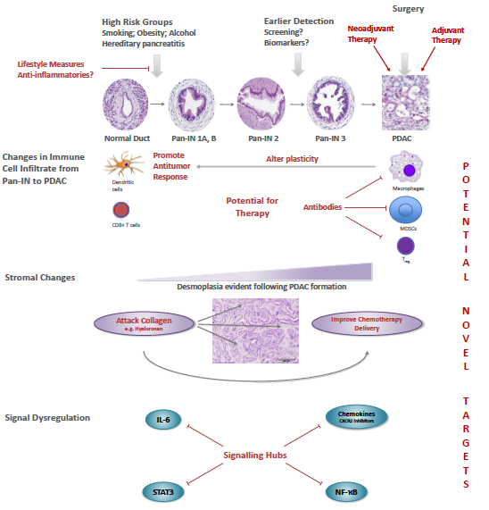
Exploiting inflammation for therapeutic gain
in pancreatic cancer
Steele, C., N. Jamieson, Carter R
British Journal of Cancer. (2013).
Anti- inflammatories work!
Lifestyle modifaction
Inhibition of tumour promotion
Direct targeting of Pro-oncogenic inflammatory cell infiltrate
Improve chemo-penetration through desmoplastic inhibition
Direct signalling pathway interaction

Slide 57
What then makes a difference for patients that contributes to weight stabilisation?
Multi-disciplinary symptom relief interventions
Stent insertion for relief of jaundice
Use of steroids/NSAIDs
Anti-emetics, anti-diarrhoeals, etc.
Pain relief management
ONS and CREON

Slide 58
?

Slide 60
Predisposing factors:
Cigarette smoking:
20 c.p.d. trebles incidence of cancer
34,000 British male doctors studied
20,000 deaths 1951-1991
Doll et al. Br Med J 309, 901 (1994)
Diabetes:
50 patient study found 37 with overt diabetes / abnormal GTT
Increased Insulin resistance is usual
Glucagon, Somatostatin & islet amyloid polypeptide elevated
Successful resection leaves only elevated Somatostatin levels &
improves Insulin resistance
Permert et al Am J Surg 165,61(1993)
Hereditary pancreatitis:
This has recently been shown to be associated with defect of
Trypsinogen molecule (R117H and N29I mutation)
20% risk of carcinoma pancreas at 70 years
DC Whitcomb et al (1997)
Chronic pancreatitis:
1.8% risk of cancer at 10 years
4.0% risk of cancer at 20 years
independent of sex, country of origin or type of chronic pancreatitis.
Lowenfels et al. NEJM(1993)328,1433

Slide 61
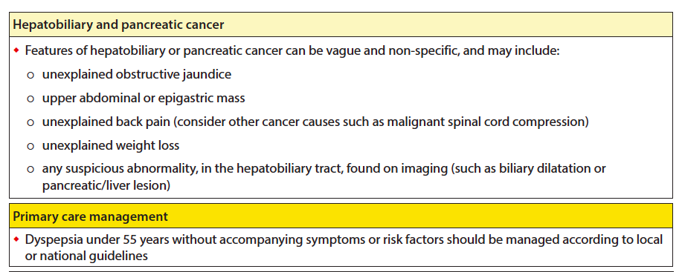
? Is earlier diagnosis a possibility

Slide 62


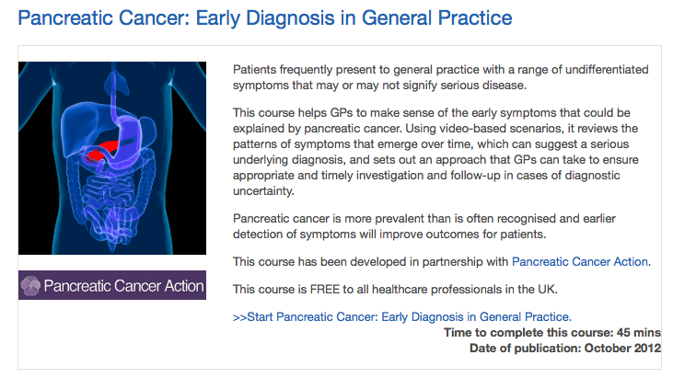

Slide 63
Early diagnosis = Pattern recognition
P – persistent dyspepsia despite PPI
D – T2 Diabetes in the wrong patient
A – anorexia and weight loss
C – change in bowel symptoms

Slide 64
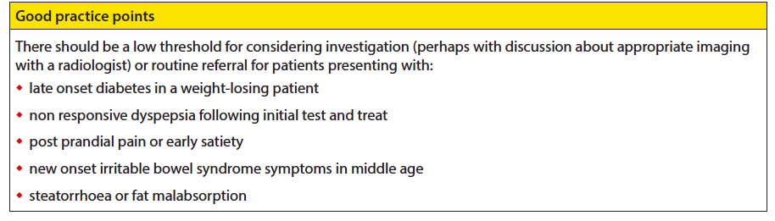

Slide 65
?

Slide 66
M.I.T.S.
Thoracoscopic
splanchnicectomy
Coeliac
Plexus block
Endoscopic control
of
ampullary tumours
Duodenal
obstruction

Slide 67
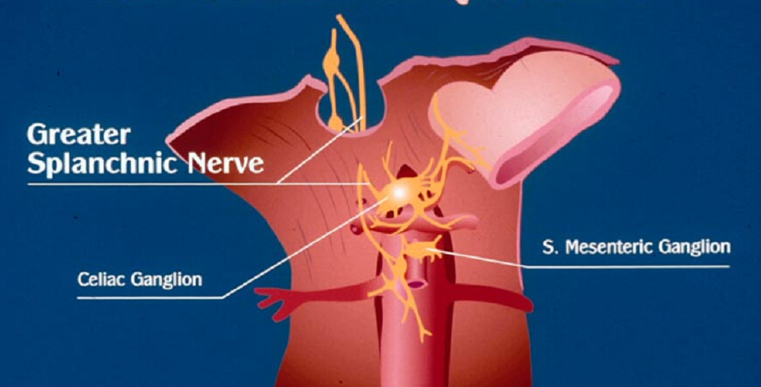

Slide 68
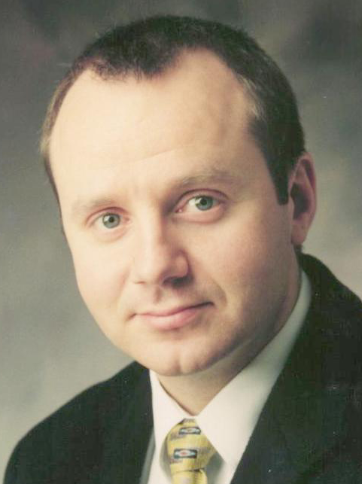
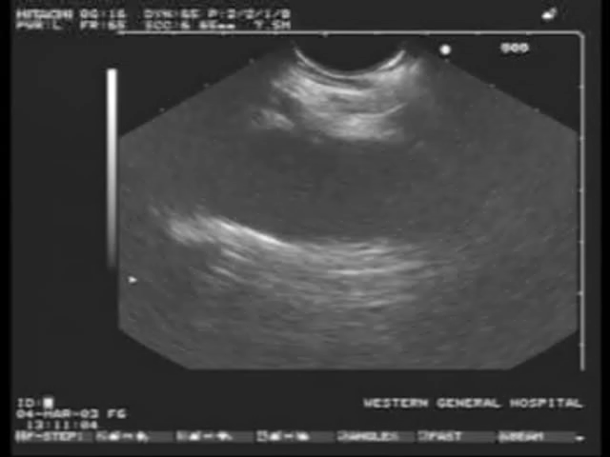
Coeliac plexus block
Mr Colin J McKay
Glasgow Royal

Slide 69
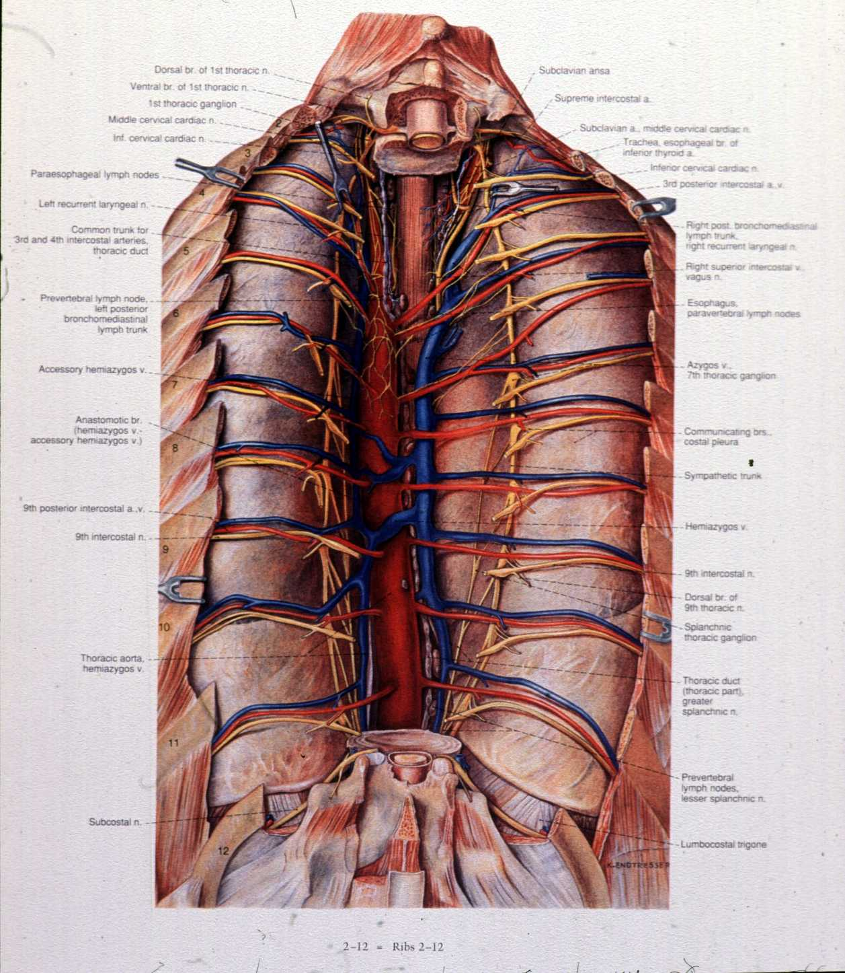
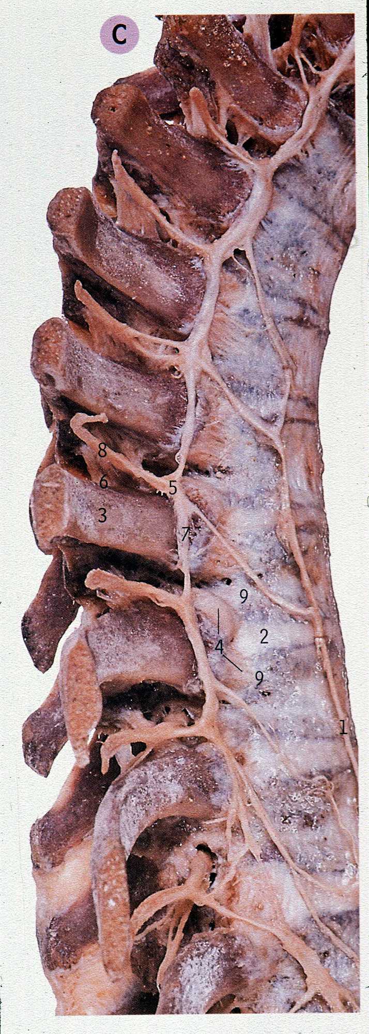
The Splanchnic Nerves

Slide 70
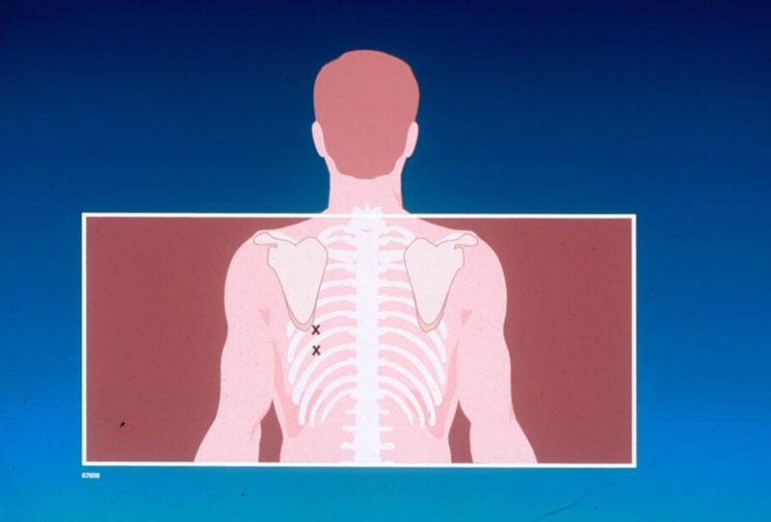

Slide 71
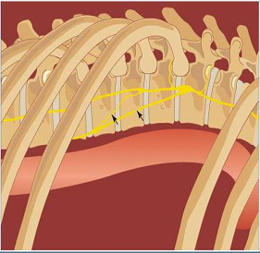
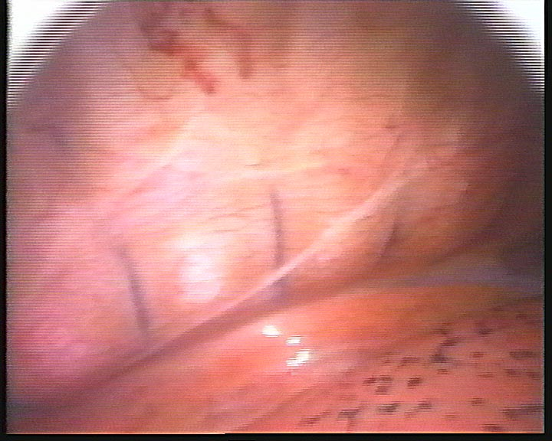
Finding the Splanchnic Nerves

Slide 72

M I T S (SPLANCHNICECTOMY)
- little time to learn
- little time to perform
- few operative problems
- few side effects
- emphatic impact on pain
Notes:
29

Slide 73


Slide 74
Surgical approach to symptom palliation
Abdominal / back pain
Often post prandial
Presumed neuropathic pain, but maybe not ?
Nutritional failure
Dyspepsia
GI dysmotility
Exocrine failure
Obstructive symptoms (GI and biliary)
Bleeding

Slide 75
Surgical approach to symptom palliation
Abdominal / back pain
? Alternative aetiology
Dietetic advice and supplementation
PPI
Non opiate analgesia
Pancreatic enzyme supplementation
Obstructive symptoms (gastric outlet obstruction)
Bleeding

Slide 76
Duodenal obstruction Choice of palliative technique
limited comparative studies (size and number) comparing surgical bypass and endoscopic stenting
Studies have been vs open surgery
Systemic review ( 2 randomised and 6 cohort studies)
Jeurnink SM: BMC Gastroenterol. 2007 Jun 8;7:18
Stent short-term advantages
Gastro-jejunostomy long-term functionality

Slide 77



Endoscopic palliation
poor functional status
large tumour burden
poor prognosis
Surgical bypass
good functional status
low tumour burden
laparoscopic

Slide 78

Endoscopic control of ampullary tumours

Slide 79

Laparoscopic resections
Laparoscopic Whipple
Gagner M et al Surg Endosc. 1994 May;8(5):408-10
Laparoscopic Distal pancreatectomy
Fernandez-Cruz L et al J Gastrointest Surg. 2007;11(12):1607-21
Radical antegrade modular pancreatosplenectomy (RAMP)
Strasberg S et al J Am Coll Surg. 2007 Feb;204(2):244-9
Feasible yes
Reasonable probably for left resections

